Slide 1
Week 10. Comparing Models
A. Michelle Lawing, PhD
Associate Professor
Paleobiology, Evolution, and Climate Lab
Ecology and Conservation Biology
Texas A&M University
alawing@tamu.edu

Slide 2
Welcome, hello, any announcements?

Slide 3
Upcoming Project Milestones
Upcoming Lab
Date | Lab
Oct. 30 | Lab 06
Date | Milestone
Nov. 6 | Preliminary Results

Slide 4
Class Plan
Chapter 9 Evaluating Niche Models
Comparing models
Lab 06 code

Slide 5
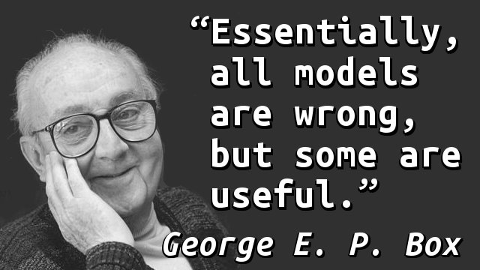

Slide 6
How do we know whether a model is useful?
We use model evaluation to determine performance and significance
  Performance: How well does the model achieve its intended purpose?
  Significance: Does the model perform better than expected under a null hypothesis?
Please note that a model can be statistically significant without being particularly useful and a model can have good performance without being significantly different from the null expectation.

Slide 7
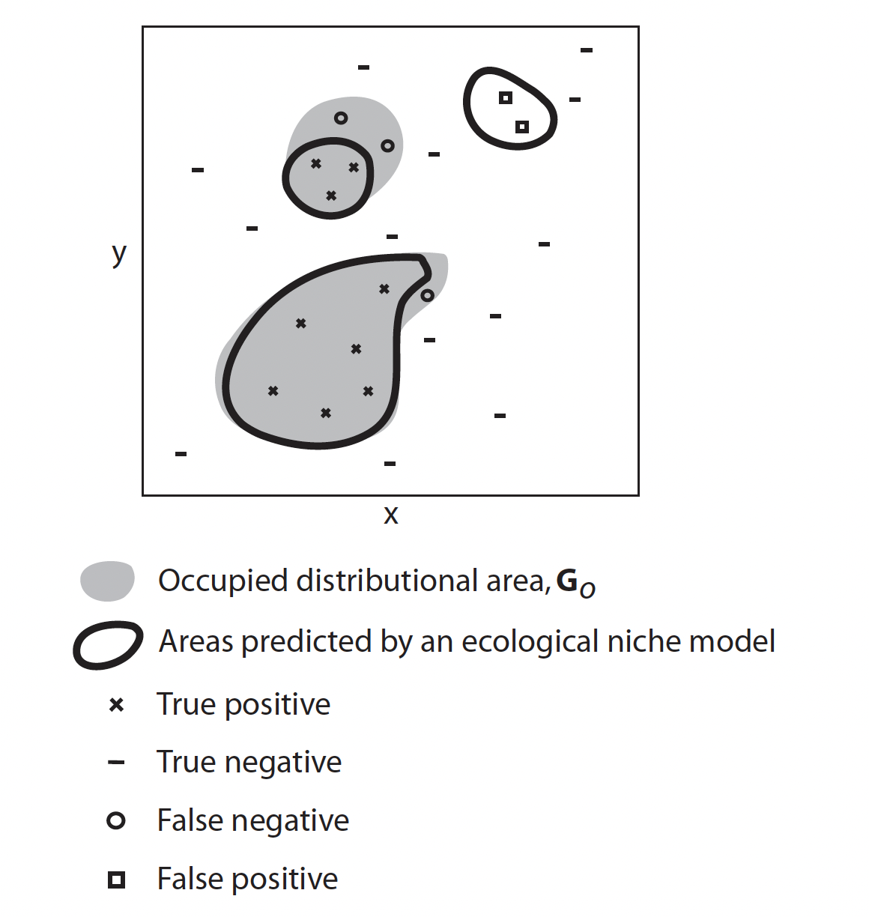
Two types of prediction error
Omission error (false negative) - The species is present, but the model predicts absence or unsuitable conditions. The model fails to identify a known occurrence.
Commission error (false positive) - The model predicts presence or suitability where the species is recorded as absent.
  Please note that an apparent commission error may not be a real error.
  The species may be absent because of dispersal limitations, biotic interactions, or incomplete sampling, even when the environment is suitable. This is something you can address in your Discussion section.

Slide 8
Calibration versus evaluation data
We need to evaluate models using data not used to fit them.
  Calibration (training) data are used to fit the relationship between occurrences and environmental predictors.
  Evaluation (testing) data are used to assess how well the fitted model generalizes.
Important considerations:
  Evaluating a model on training data can give overly optimistic results.
  Nearby records may not be statistically independent because of spatial autocorrelation.
  Randomly splitting a biased dataset does not remove the underlying sampling bias.

Slide 9
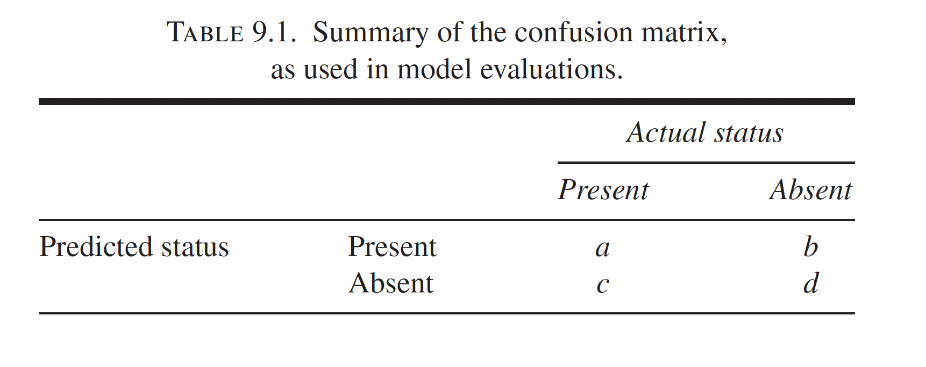

Slide 10
Use the confusion matrix to calculate metrics
Measure | Formula | Definition
Sensitivity | a/(a+c) | Proportion of actual presences correctly predicted
Specificity | d/(b+d) | Proportion of actual absences correctly predicted
Omission error | c/(a+c) | Proportion of presences missed
Commission error | b/(b+d) | Proportion of absences predicted present
Accuracy | (a+d)/(a+b+c+d) | Proportion of all observations classified correctly

Slide 11
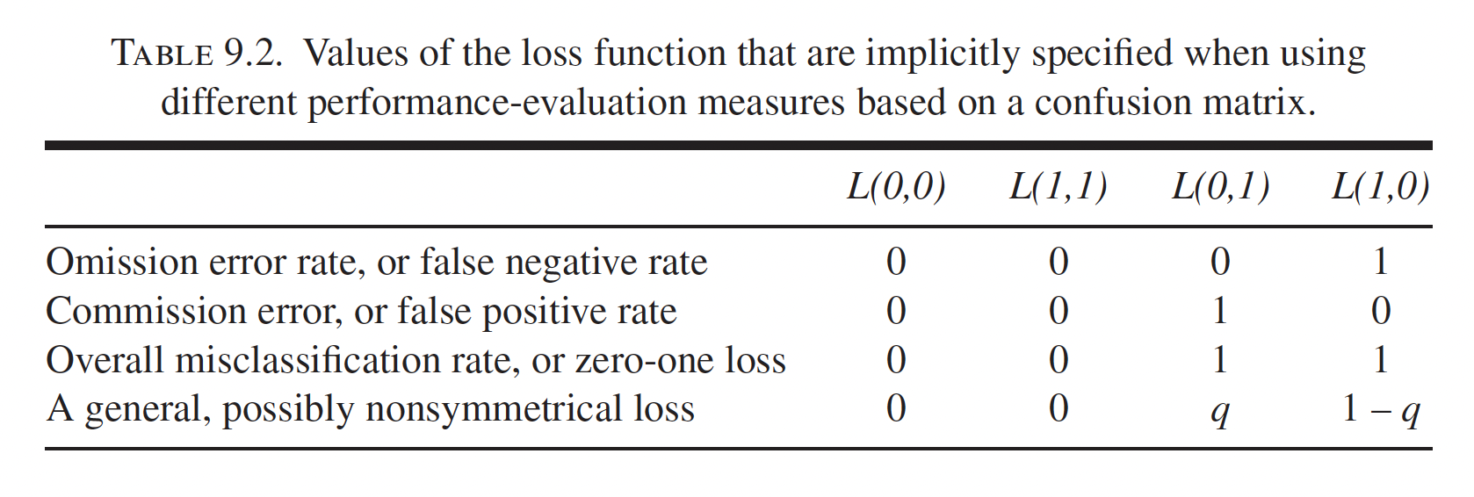
Loss functions
Loss functions assign costs to different outcomes.
Zero-one loss functions give equal penalties to both errors.
Asymmetric loss functions allow one kind of error to matter more.

Slide 12
Loss function choice depends on what you are trying to predict
Actual occurrence or occupied distribution?
Environmental suitability or potential distribution?
Do you have true absences or only background?
Which kinds of errors matter for the biological application?

Slide 13
What aspect of model performance are we measuring?
Discrimination - Can the model distinguish known occurrences from absences or background locations?
Goodness of fit / probability calibration - How well do occurrence probabilities correspond to observed frequencies?
Different evaluation measures answer different questions. For example:
  Sensitivity tells about the proportion of known presences correctly predicted.
  Specificity tells about the proportion of true absences correctly predicted.
  AUC tells about the ability to rank presences above absences or background locations across thresholds.

Slide 14
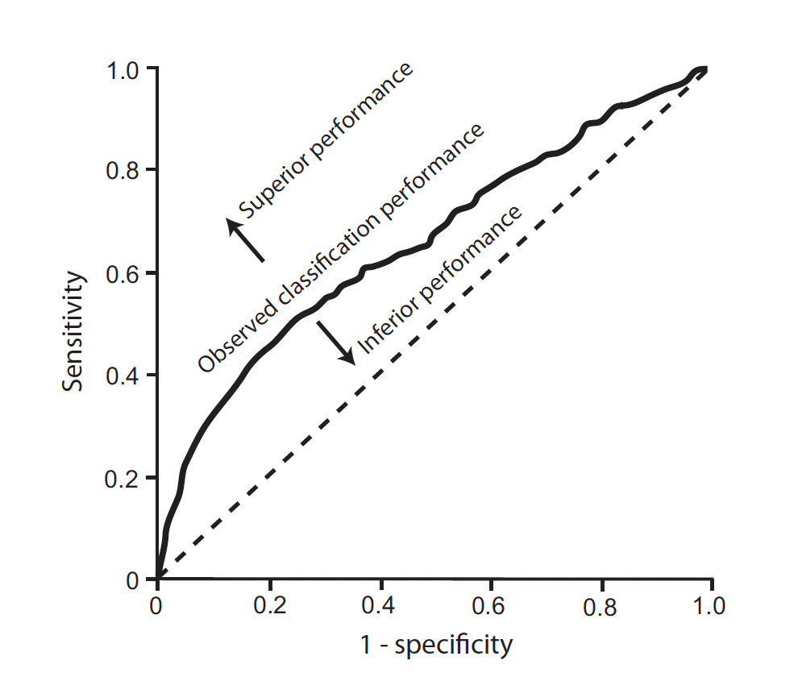
ROC curves
Receiver Operating Characteristic (ROC) plots model performance across classification thresholds.
  Y-axis: sensitivity (true positive rate)
  X-axis: 1 − specificity (false positive rate)
Dashed line is the expected performance of a random classifier (for presence/absence evaluation data).
Solid line is the observed performance in this hypothetical example.

Slide 15
AUC
Area Under the Curve (AUC) summarizes the model's ranking ability across thresholds.
  AUC is widely used, but interpretation depends on the evaluation data.
  With presence/background data:
    background points are not confirmed absences;
    AUC measures discrimination of presences from background;
    the result depends on the geographic region used to sample background.
Dashed line is the expected performance of a random classifier (for presence/absence evaluation data).
Solid line is the observed performance in this hypothetical example.

Slide 16
Evaluating our first models
Lab 06: Comparing and evaluating models
We will:
  Fit a GLM and a GAM using the same data.
  Compare how they represent environmental response curves.
  Evaluate their predictions using held-out data.
  Examine whether greater complexity improves performance.
  Consider what the evaluation results actually tell us.

Slide 17
Training Data
# Reuse the model-ready data from Lab 05
> set.seed(689)
> train_rows <- sample(seq_len(nrow(model_data)),
size = floor(0.8 * nrow(model_data)))
> training_data <- model_data[train_rows, ]
> test_data <- model_data[-train_rows, ]

Slide 18
Fitting GLM/GAM models
# Same observations and predictors but different model structures
> model_glm <- glm(presence ~ bio1_c + bio12_mm,
data = training_data, family = binomial())
> model_gam <- mgcv::gam(presence ~ s(bio1_c, k=4) + s(bio12_mm, k=4),
data = training_data, family = binomial())

Slide 19
Calculate predictions from testing data
# Predict on records not used in model fitting
> test_data$glm_score <- predict(model_glm, newdata = test_data,
type = "response")
> test_data$gam_score <- predict(model_gam, newdata = test_data,
type = "response")

Slide 20
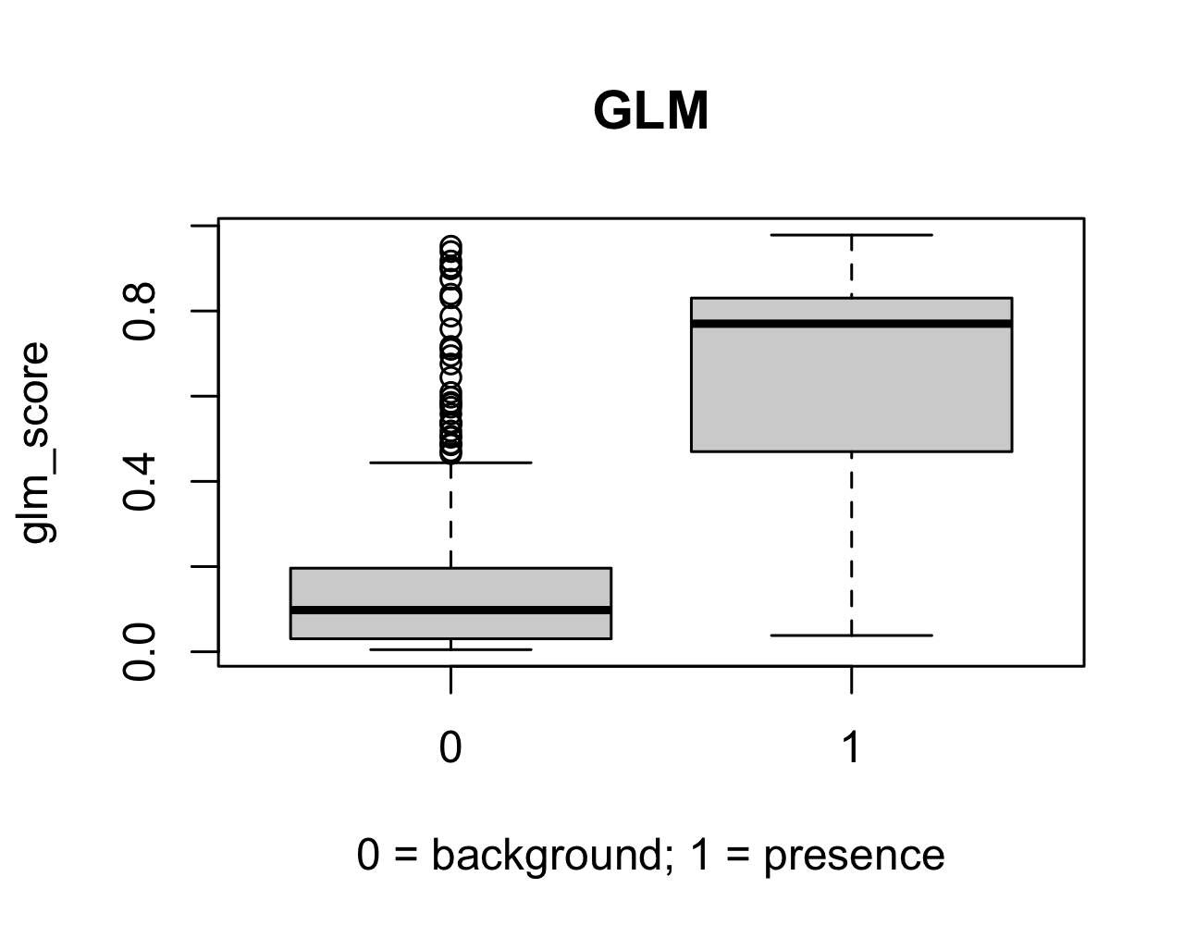
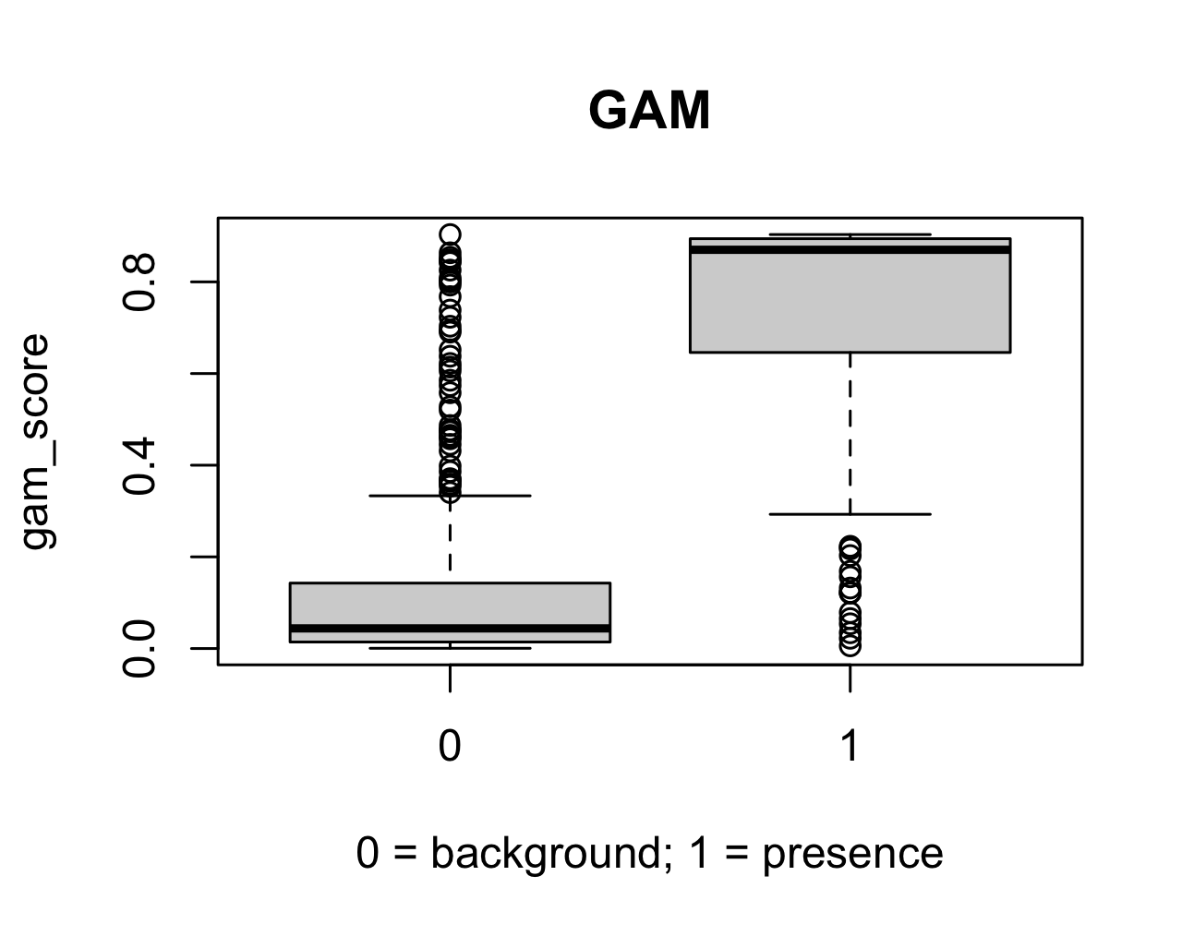
Examine predictions
# Do higher model scores tend to occur at known presences?
> boxplot(glm_score ~ presence, data = test_data, xlab = "0 = background; 1 = presence", main = "GLM")
> boxplot(gam_score ~ presence, data = test_data, xlab = "0 = background; 1 = presence", main = "GAM")

Slide 21
Lab 06 workshop

